Slide 1
AI Research Assistant
Team : Naga Bathula, Sai Pragna Kancheti, Chirudeep , Sravani Raparla

Slide 2
AI Research Assistant
Purpose: Enhance academic research efficiency.
Core Features:
Article Search: Utilizes ArXiv dataset metadata from Kaggle, with advanced search capabilities powered by embeddings stored in Pinecone index.
PDF Summarization & Chat: Offers PDF upload for quick summarization and an interactive chat feature for user engagement and clarification.
Benefits:
Facilitates quick access to relevant academic articles.
Simplifies the comprehension of complex scholarly material.
Target Users: Researchers, students, and academics.

Slide 3
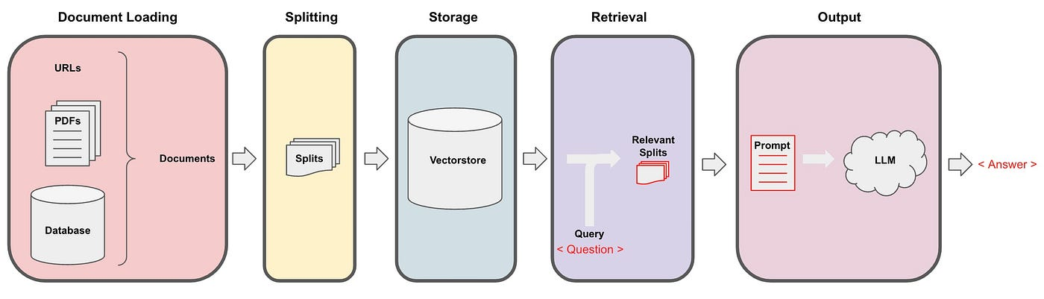
Architecture - PDF Summarization & Chat

Slide 4
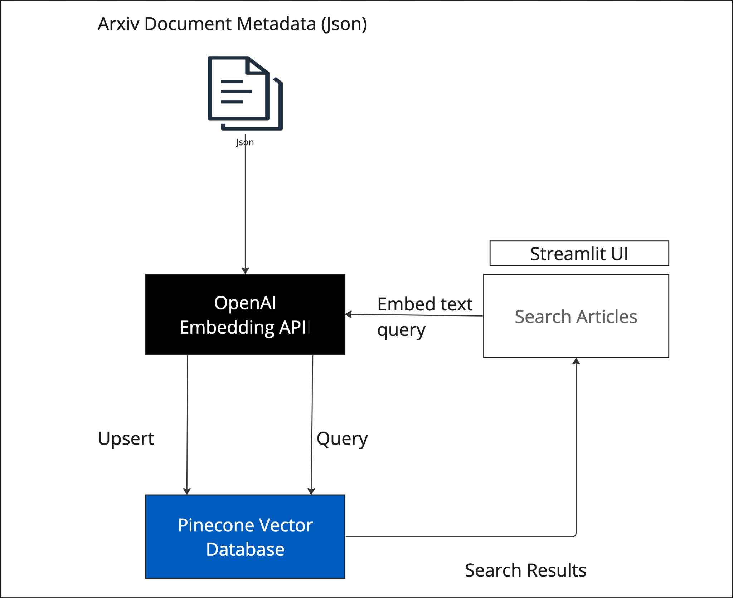
Architecture - Search Articles

Slide 5
Technology
openai==1.3.9
pinecone_client==2.0.13
tiktoken
tqdm==4.64.1
PyPDF2==3.0.1
streamlit==1.29.0
faiss-cpu==1.7.4
streamlit-extras
langchain
langdetect==1.0.9

Slide 6
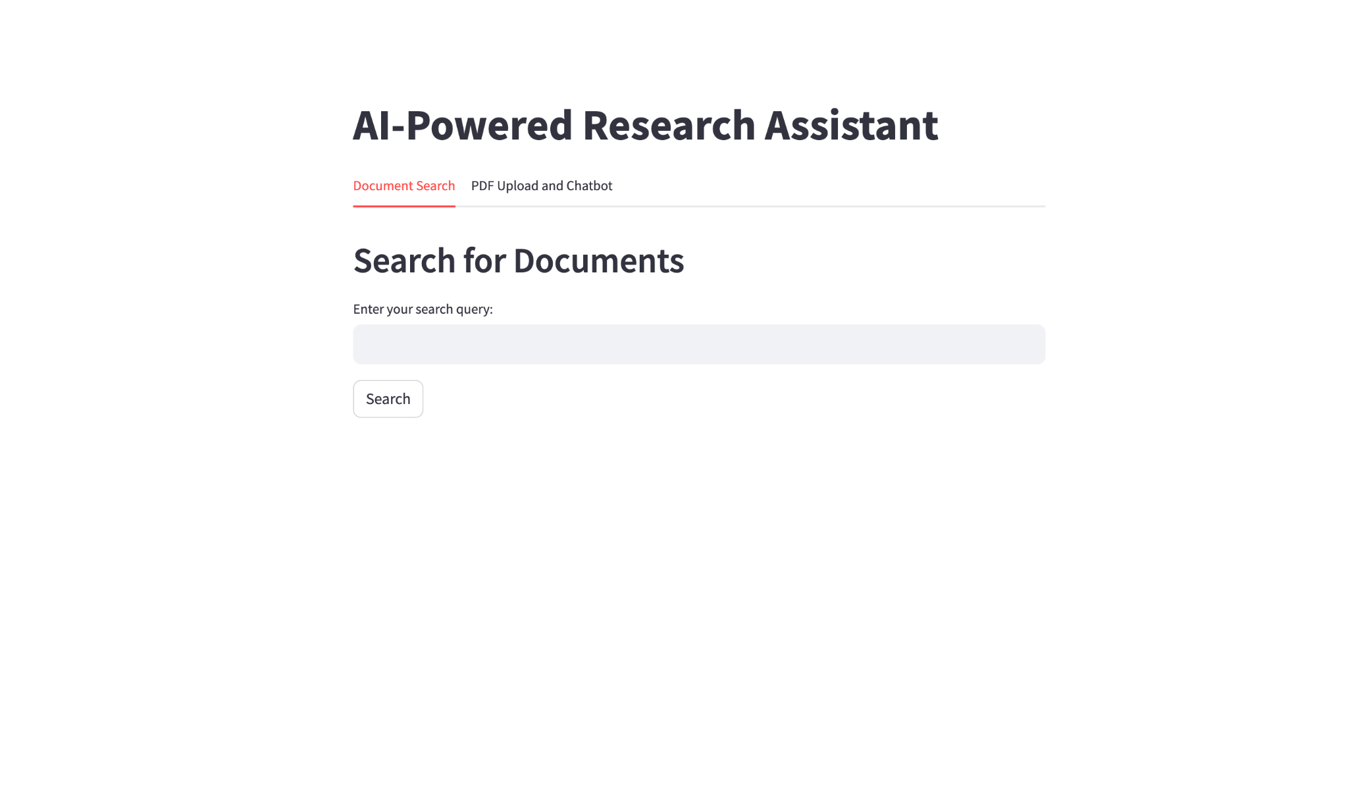
Demo

Slide 7
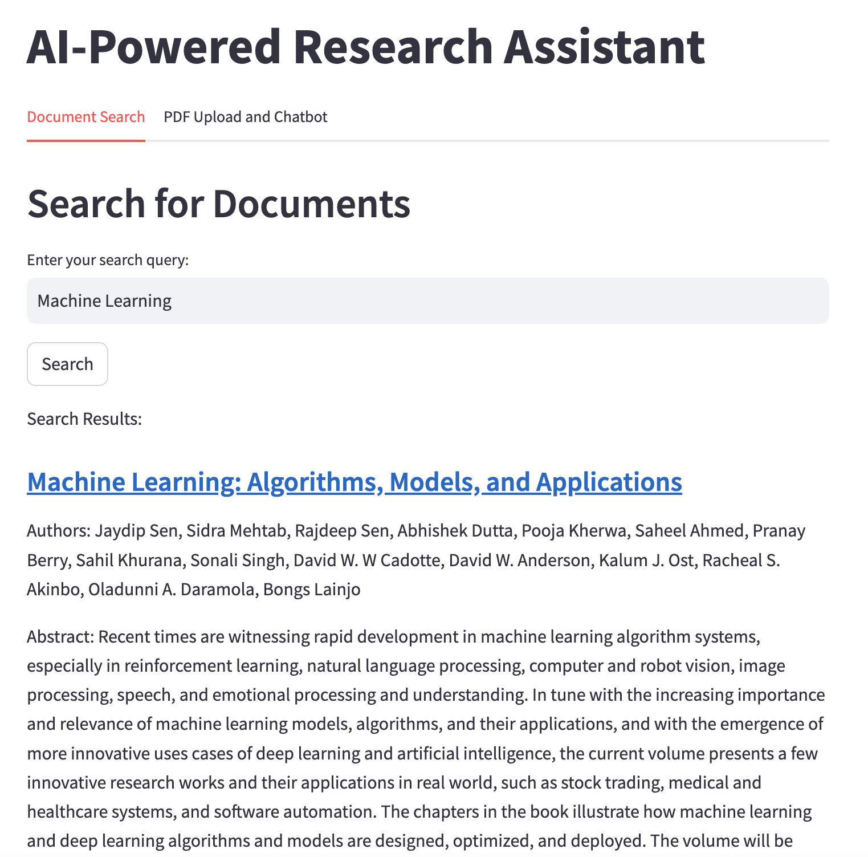
Demo

Slide 8
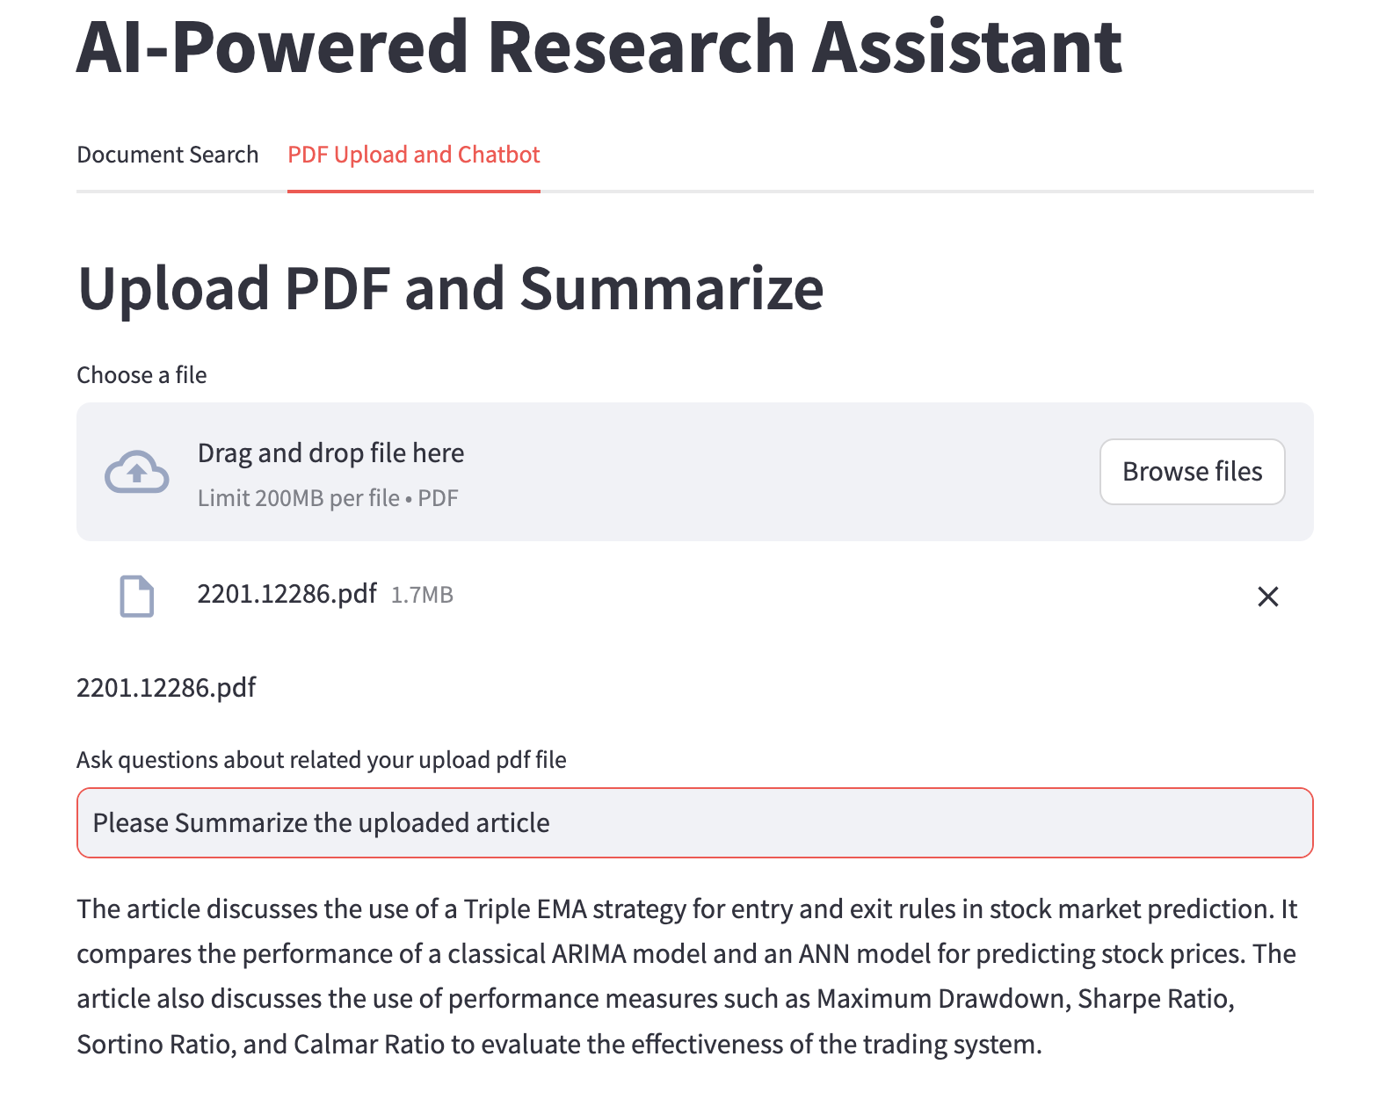
Demo

